Slide 1
Contributing to UFS/EPIC GitHub Repositories https://github.com/DavidHuber-NOAA/UIFCW_Demo

Slide 2
Welcome!
Please navigate to https://github.com/DavidHuber-NOAA/UIFCW_Demo
Note this tutorial assumes you are on a Mac or Linux-like system
Git-Bash for Windows will also work: https://git-scm.com/download/win
AWS instances are available if you do not have access
Complete all prerequisite steps

Slide 3
Part 1. Git/GitHub Basics
Cover some Git/GitHub definitions
Basic Git commands to git you through the day
Set up a GitHub SSH key pair for easy authentication
Create your own repository
Track your local changes
Push your local changes to GitHub

Slide 4
Basic Definitions
Git: A free, open-source version control system
Version control system (VCS): provides management of changes to computer programs, documentation, web sites, etc
Git is a distributed VCS, meaning there can be many copies of the same repository
Differs from centralized VCSs (like Subversion), which have a single, central repository
Repository: a set of code, documents, website(s), etc that are version controlled
GitHub: The host website for many free and open-source repositories, including numerous NOAA
Branch: a working version of a repository with its own change history

Slide 5
Common Local Git Commands
config: configure your git experience
init: create a new, local repository
add: add files to be tracked by git
commit: save changes you have made to the repository
branch: copy the current branch to create a new one
checkout: check out a specific branch within a repository
log: show change history to the repository
status/diff: show local file/line-by-line changes to the repository

Slide 6
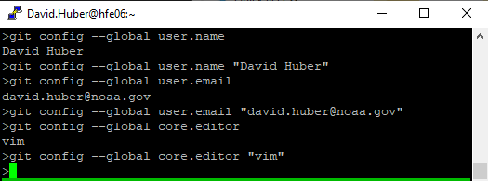
Common Local Git Commands
config: configure your git experience
init: create a new, local repository
add: add files to be tracked by git
commit: save changes you have made to the repository
branch: copy the current branch to create a new one
checkout: check out a specific branch within a repository
log: show change history to the repository
status/diff: show local file/line-by-line changes to the repository

Slide 7
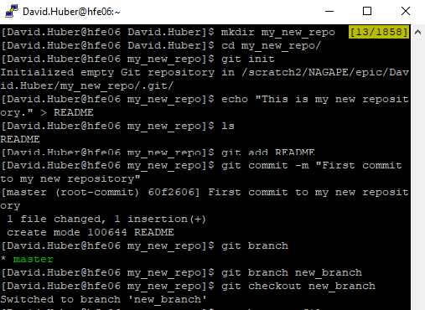
Common Local Git Commands
config: configure your git experience
init: create a new, local repository
add: add files to be tracked by git
commit: save changes you have made to the repository
branch: copy the current branch to create a new one
checkout: check out a specific branch within a repository
log: show change history to the repository
status/diff: show local file/line-by-line changes to the repository

Slide 8
Common Local Git Commands
config: configure your git experience
init: create a new, local repository
add: add files to be tracked by git
commit: save changes you have made to the repository
branch: copy the current branch to create a new one
checkout: check out a specific branch within a repository
log: show change history to the repository
status/diff: show local file/line-by-line changes to the repository

Slide 9
Common Local Git Commands
config: configure your git experience
init: create a new, local repository
add: add files to be tracked by git
commit: save changes you have made to the repository
branch: copy the current branch to create a new one
checkout: check out a specific branch within a repository
log: show change history to the repository
status/diff: show local file/line-by-line changes to the repository

Slide 10
Common Local Git Commands
config: configure your git experience
init: create a new, local repository
add: add files to be tracked by git
commit: save changes you have made to the repository
branch: copy the current branch to create a new one
checkout: check out a specific branch within a repository
log: show change history to the repository
status/diff: show local file/line-by-line changes to the repository

Slide 11
Common Local Git Commands
config: configure your git experience
init: create a new, local repository
add: add files to be tracked by git
commit: save changes you have made to the repository
branch: copy the current branch to create a new one
checkout: check out a specific branch within a repository
log: show change history to the repository
status/diff: show local file/line-by-line changes to the repository

Slide 12
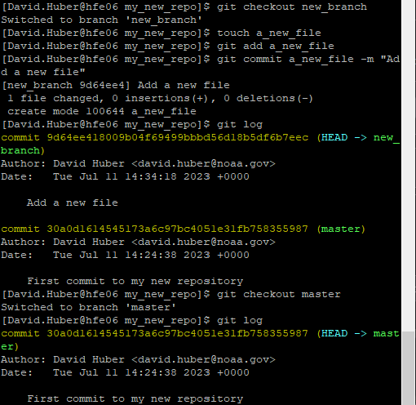
Common Local Git Commands
config: configure your git experience
init: create a new, local repository
add: add files to be tracked by git
commit: save changes you have made to the repository
branch: copy the current branch to create a new one
checkout: check out a specific branch within a repository
log: show change history to the repository
status/diff: show local file/line-by-line changes to the repository

Slide 13
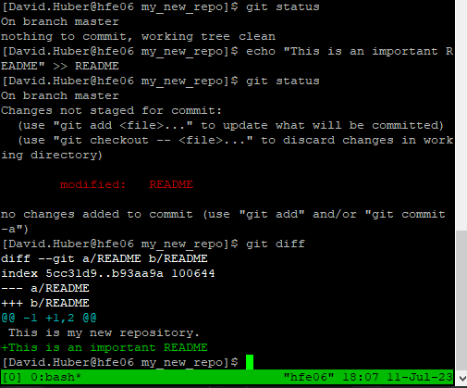
Common Local Git Commands
config: configure your git experience
init: create a new, local repository
add: add files to be tracked by git
commit: save changes you have made to the repository
branch: copy the current branch to create a new one
checkout: check out a specific branch within a repository
log: show change history to the repository
status/diff: show local file/line-by-line changes to the repository

Slide 14
Creating a public profile
Navigate to https://github.com
Click on your picture, then settings
Fill out your public profile

Slide 15
Generate SSH key pair for easy Git/GitHub communication
From settings, on the left, click on “SSH and GPG keys”, then “New SSH key”
In a terminal, navigate to ~/.ssh and execute
ssh-keygen -t rsa -b 4096 -C your_email@example.com
Call it whatever you like and place it in .ssh
cat id_rsa.pub # Copy the output key
Paste the output into the “Key” portion of the GitHub page
Give it a title and click “Add SSH key”
Now pushes to your GitHub repositories will not require a password!

Slide 16
Creating a repository on GitHub
Head to https://github.com/new
Give your new repository a name (My_New_Repo) and optionally a description
Since we will be pushing our repository from the terminal, do not select “Add a README file”
Click “Create repository”

Slide 17
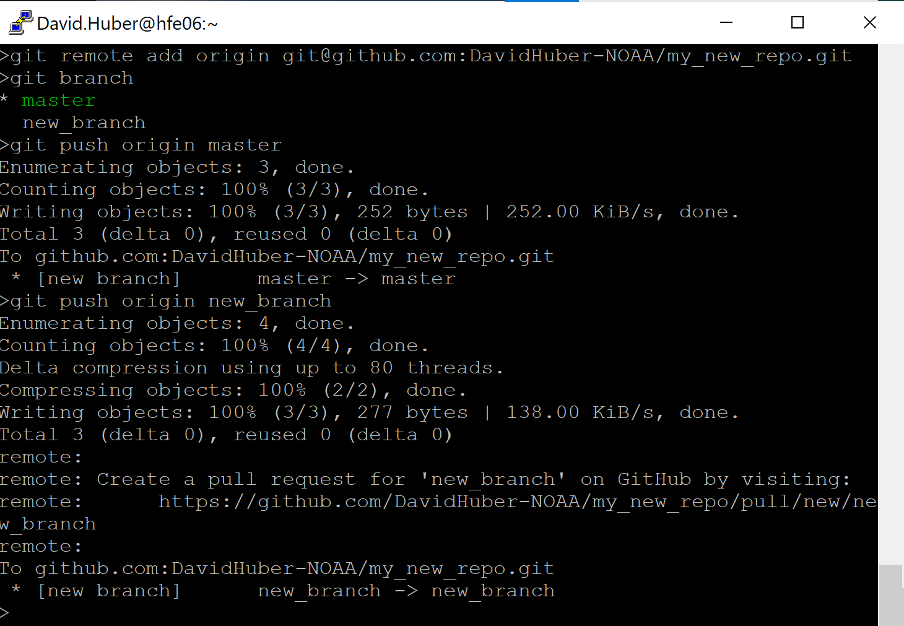
Pushing a Repository to GitHub
Go back to your terminal and navigate back to your new repository (my_new_repo)
Set the remote URL for the repository
git@github.com:<GitHub username>/my_new_repo.git
Push both branches to GitHub
Congrats on your new repo!! Go check it out on GitHub!

Slide 18
Part 2. Working with Remote Repositories
Perusing GitHub repository branches, pull requests, issues, and discussions
Checkout remote repositories
Fetching and merging remote branches
Creating and managing forks
Submitting pull requests
Performing code reviews, approving, and merging pull requests
Keeping local repositories in sync with remote ones

Slide 19
Navigating GitHub Repositories and Creating Forks
Navigate to https://github.com/DavidHuber-NOAA/UIFCW_demo
Look through the issues and pull requests
Hop onto the discussions and reply to a thread
Create your own fork of the repository
Navigate to the main repository page by clicking on “Code”
In the top-right corner, click on “Fork”
Keep the “Repository name” and “Description” fields unchanged
Click “Create fork”

Slide 20
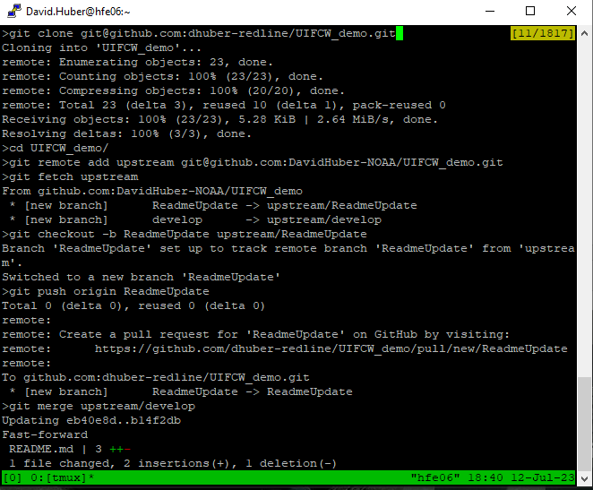
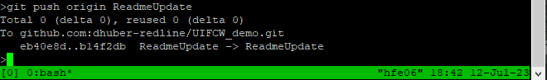
Clone a remote repository
In a terminal, clone the UIFCW_demo repository
Now link up to the authoritative repo (remote)
Fetch another fork’s branches
Checkout another fork’s branch
Push the branch branch to your GitHub repository
Merge changes from a remote branch into your branch, then push to GitHub

Slide 21
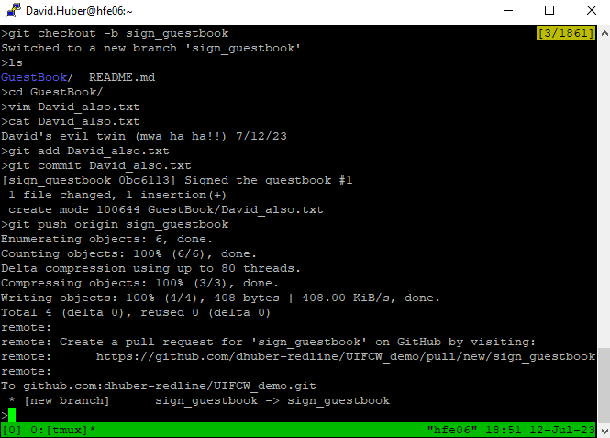
Creating a Pull Request, Part 2
UIFCW_demo repository, checkout a new branch
Sign the guest book
cd GuestBook
vim,emacs,nano,gedit <your name>.txt # Add your name and the date
git add <your name>.txt
git commit <your name>.txt
In your editor, enter a commit message like “Signing the guestbook #1”
Save and quit
Push your guest book entry to GitHub
Open a pull request to the DavidHuber-NOAA develop branch

Slide 22
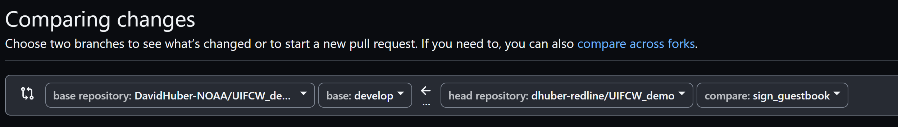
Creating a Pull Request, Part 2, con’t.
Open a pull request to the DavidHuber-NOAA develop branch
Navigate to https://github.com/<your GitHub username>/UIFCW_demo
Click on Pull requests
Then New pull request
Select your head repository and the “sign_guestbook” on the right side from the pull-down menus

Slide 23
Updating your local branches
Head back into your local copy of UIFCW_demo
Checkout your repositories develop branch (“get checkout develop”)
Check that you are connected to the authoritative repo (“git remote –v”)
Fetch from the authoritative repository to update the tracking info (“git fetch upstream”)
Merge in the changes to the develop branch to your working one (“git merge upstream/develop”)
Push your changes back to GitHub (“git push origin develop”)
Check out the version history (“git log”)

Slide 24
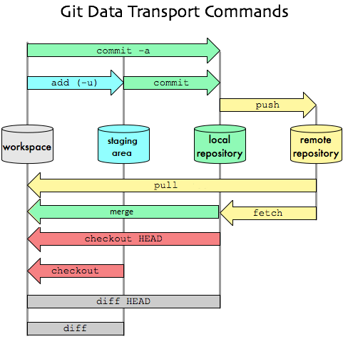
Interacting with local and remote repositories
Git allows interaction with multiple layers
Practice the contribution commands on the right
Start by making three copies of the demo
`cp -rf UIFCW_demo UIFCW_demo_fetch`
`cp -rf UIFCW_demo UIFCW_demo_fetch`
`cp -rf UIFCW_demo UIFCW_demo_conflict`
Find my misspelling in UIFCW_demo/GuestBook/David.txt
Try all 3 options to commit the change
`git commit -a`
`git add David.txt; git commit`
`git add -u; git commit`
Push to your repo
Contribute
Sync
Revert
Compare

Slide 25
Interacting with local and remote repositories
Now, let’s sync our changes locally
Head into UIFCW_demo_fetch
`git fetch; git merge`
UIFCW_demo_pull
`git pull`
What if there are differences between the local and remote repo?
Head into UIFCW_demo_conflict
‘Fix’ David.txt a different way; commit
Now `git pull`, what happens?
Fix the conflict, commit again, push
Contribute
Sync
Revert
Compare

Slide 26
Interacting with local and remote repositories
What if we make a mistake?
In UIFCW_demo, make a README change
`git add`
`git diff HEAD`
`git checkout -- README` # Why the --?
Do it again, but commit it
`git commit -a`
`git diff HEAD`
`git reset HEAD~1`
Edit README
`git commit -a`
Contribute
Sync
Revert
Compare

Slide 27
Interacting with local and remote repositories
What if we make a mistake, con’t?
Do it again, but push it
`git commit -a`
`git push origin develop`
`git reset HEAD~1`
Edit README
`git commit -a`
`git push origin develop --force`
Contribute
Sync
Revert
Compare

Slide 28
Part 3. Perusing Public Repositories
Check out a few different repositories with submodules
Submitting issues
Reaching out for help through discussions
Navigating documentation
Start at https://github.com/DavidHuber-NOAA/UIFCW_Demo

